Slide 1

Module 3
Development Environment

Slide 2
Overview
This module will explore the Corda Community, available resources, toolchain and walk through running some demos. Learning outcomes:
Learn about the Corda toolchain
Set up development environment and resolve common issues
Run some sample CorDapps
Understand what resources are at your disposal

Slide 3
Repositories
The Corda code is hosted on Github:
https://github.com/corda
Four key repositories:
  corda: The open-source Corda platform code
  cordapp-template (Java or Kotlin): A boilerplate CorDapp in both languages to kick-start CorDapp development
  cordapp-example: A simple example CorDapp

Slide 4
Releases
Corda no longer follows a basis of monthly releases following Corda v1.0
Currently on v4.x
Corda open- sourced
Corda 1.0
and 2.0
Corda 3.x
Corda Enterprise 3.0
Milestone 0
Milestone 6
= API stability + New features
= API stability + New features
Apr-18 Sep-18
Corda 4.x
Mar-16
Aug-16
Jan-17
Jun-17
Nov-17
Feb-19

Slide 5
Snapshots
Throughout the month, the R3 platform team merge reviewed pull requests to master
Building the HEAD of master results in a SNAPSHOT release
SNAPSHOTS are numbered one higher than the last milestone
Therefore, as we are on v4.x, new snapshots are created as
5.x-SNAPSHOT
Snapshots are the latest version of the code base
Snapshots can be unstable!

Slide 6
Prefer releases
Unless you require new the functionality offered by a SNAPSHOT release, always use the latest Release
Releases are thoroughly tested
Although SNAPSHOTS are continuously tested, sometimes mistakes slip through the net
Always remember to check out the latest Release before deploying your CorDapps or running the demos.

Slide 7
Choosing a release
Releases are available as branches in all repos
Check out a given stable Release using:
git checkout release-V[**VERSION-NUMBER**]
Releases can also be enumerated with:
git tag
Corda Releases are published to Maven, so Corda does not need to be installed to compile CorDapps
SNAPSHOTs are always on master

Slide 8
Toolchain
The following is required run/develop CorDapps:
JVM
IDE
Source control
Build system
Oracle JDK 8 (latest version ideally – u171 min) IntelliJ IDEA Community Edition 2017.2.x and 2018.x Git
Gradle
CorDapps can be written in any JVM language although Corda itself is written in Kotlin, which has excellent Java interoperability

Slide 9

Getting set up - instructions
 | Goal | Get your machine set up for Corda development
 | Steps | Follow the instructions on getting set up: https://docs.corda.net/quickstart-index.html Clone the main Corda repo Check out v4.x (“release-V4.x”) Open the main Corda repo in IDEA intelliJ If you encounter any issues, refer to the Troubleshooting page: https://docs.corda.net/troubleshooting.html

Slide 10
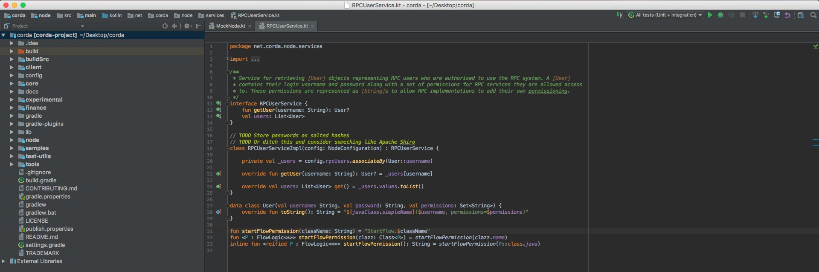
IntelliJ IDEA
The IDE is divided into a project window and a code window
If the project window is hidden, show it using ⌘1/Alt + 1
Demos and debugging can accessed via “Run Configs” menu
3. Run Configs
1. Project Window
2. Code Window

Slide 11
Gradle
Corda and CorDapps are built using Gradle
If there are no folders or modules in the IDEA project window, the Gradle project must first be imported
Instructions on how to do this can be found here:
https://docs.corda.net/troubleshooting.html#no-source-files- are-present

Slide 12
Key IDEA shortcuts
IDEA provides some useful shortcuts:
Search everywhere (double-press Shift): Allows you to find the declarations for classes, functions, etc. by name
See declaration (Ctrl+B and click/⌘B and click): Allows you to navigate to the declaration of a class or function to see its fields, methods, params, etc.

Slide 13
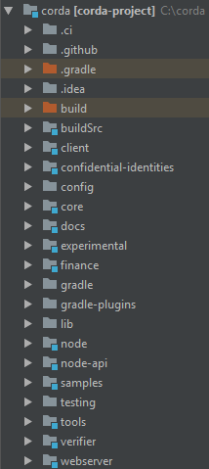
The Corda repository
Gradle plugins source code
Security flows (new from v1.0) Corda core classes
The platform documentation (also on docs.corda.net)
The Gradle plugins used to deploy Corda nodes
Node implementation internals (non-public APIs) Sample CorDapps, demonstrating cash, oracles… Testing DSLs and utilities

Slide 14
Exploring the Corda repo
There are quite a few modules defined in the main Corda repo!
We’ll now spend a bit of time walking through the content of
the main Corda repo and the CorDapp template repo
There is a lot going on – we can help you focus on the most relevant areas

Slide 15
Running a sample CorDapp - instructions
Goal | Run the Corda Example
Steps | Follow the instructions on running the Corda example demo here: https://docs.corda.net/tutorial-cordapp.html Run the demo from both IDEA and the command line If you encounter any issues, refer to the Troubleshooting page: https://docs.corda.net/troubleshooting.html or ask us!

Slide 16
Resources
Documentation (https://docs.corda.net/)
  Has tutorials (e.g. https://docs.corda.net/tutorial-contract.html)
  API reference (https://docs.corda.net/api/javadoc/index.html)
Slack (https://slack.corda.net/)
  Great for quick questions about design and implementation
  Our entire dev team hangs out there
Stack Overflow (https://stackoverflow.com/questions/tagged/corda )
  Replaces “discourse” for technical Q&A
  Discourse is still used for non-tech discussions
  Only recently started migrating; not many questions there yet
Corda.net
  Key announcements (e.g. Releases)
  Blog posts on key topics

Slide 17
Summary
Corda release process
Releases versus Snapshots
The available repos
Gradle – build automation
IntelliJ IDE
Running a demo

